Slide 1
UNIVERSITY OF GREENWICH
Stochastic Diffusion Search for Optimized Feature Selection Across Diverse Datasets
Supervisor: Dr. Mohammad Majid Al-Rifaie
Name: Masood Manzoor Ahmed
Student ID: 001370053
Course of Study: MSc Data Science

Slide 2
Overview
Apply Feature Selection Techniques
AIM :The aim of this project is to explore the application of Stochastic Diffusion Search (SDS), a swarm intelligence algorithm, for feature selection in high-dimensional datasets to achieve dimensionality reduction and improve classification performance.
Improve classification performance
Enhance Classification Accuracy
GOAL
Provide Insights Across Datasets
Compare Model Performance
Assess Computational Efficiency

Slide 3
This project focuses on applying feature selection techniques to high-dimensional datasets to improve classification performance.
Using nine datasets of different sizes (small, medium, and large), various methods were analyzed for their ability to reduce dimensionality and enhance accuracy.
The key techniques included Stochastic Diffusion Search (SDS), a swarm intelligence algorithm designed for effective feature selection;
Baseline Model, used without feature selection for comparison;
Principal Component Analysis (PCA), which reduces dimensionality based on variance; Recursive Feature Elimination (RFE), which iteratively selects the most important features;
Mutual Information (MI), a filter-based method ranking features by their dependency on the target variable.
Preprocessing involved handling missing values, standardizing features, and encoding labels to ensure the datasets were ready for analysis.
After Data exploration and processing, the models—Baseline, SDS, PCA, RFE, and Mutual Information were evaluated based on classification accuracy/regression r2 score and the number of features selected.

Slide 4
Types of Datasets
Small
Medium
Large
DARWIN
PARKINSON'S SPEECH
TUANDROMD
Winnipeg Crop mapping
PERIOD CHANGER
Amazon Commerce Reviews
Gene Cancer
IONOSPHERE
AIR QUALITY

Slide 5
About Datasets
TUNADROMD: TUNADROMD dataset contains 4465 instances and 241 attributes. The target attribute for classification is a category (malware vs goodware). (N.B. This is the preprocessed version of TUANDROMD)
AIR QUALITY: Air Quality UCI dataset contains 9,358 instances, 15 features, and data recorded from March 2004 to February 2005
PERIOD CHANGER: The dataset includes 90 non-toxic molecules designed for functional domain of a core clock protein, CRY1, of which 27 molecules significantly lengthen the period of circadian rhythm and the rest, 63 molecules, are no changers.
IONOSPHERE: The data comes from a high-frequency radar system in Goose Bay, Labrador, consisting of 16 phased-array antennas transmitting at 6.4 kilowatts. It measures free electrons in the ionosphere, distinguishing "good" returns (with ionospheric structure) from "bad" returns (signals passing through).
DARWIN: The DARWIN dataset includes handwriting data from 174 participants. The classification task consists in distinguishing Alzheimer’s disease patients from healthy people.
PD SPEECH: From 20 PD patients and 20 healthy individuals (26 voice samples each, including vowels, numbers, words, and sentences). Features: 26 extracted metrics per sample. Includes r2 scores for regression.Test data: 28 PD patients with 6 recordings each (3 "a" vowels, 3 "o" vowels). Same 26 features extracted.
The Amazon Commerce Reviews:Dataset consists of 1,500 multivariate text instances from customer reviews on Amazon, with features derived from linguistic styles such as punctuation, word usage, and sentence length.
Winnipeg:The Crop Mapping Using Fused Optical-Radar Dataset consists of 325,834 instances with 175 features combining optical (RapidEye) and radar (UAVSAR) remote sensing data.It focuses on cropland classification for seven crop types using bi-temporal data collected in 2012.
The Gene Expression Cancer RNA-Seq dataset contains 801 samples with 20,531 RNA-Seq gene expression features, representing patients with five tumor types (BRCA, KIRC, COAD, LUAD, PRAD).

Slide 6
Types of Models
1) Stochastic Diffusion Search (SDS).
SDS Algorithm (Pseudocode)
Initialize population of agents.
Assign random solutions to agents.
For each iteration:
Evaluate each agent’s fitness.
Update agent solutions based on neighbors.
Return the best solution found.
How it Works:
SDS is a swarm intelligence algorithm that uses multiple "agents" to search for the best feature subset. Agents share information and improve their solutions based on a performance evaluation function.
Advantages:
Can explore complex, non-linear relationships between features.
Flexible and can handle high-dimensional and noisy data.
Can effectively balance exploration and exploitation during the search.
Disadvantages:
Computationally expensive, especially with large datasets.
May require many iterations to converge to the optimal solution.
Requires careful tuning of parameters like the number of agents and iterations.

Slide 7
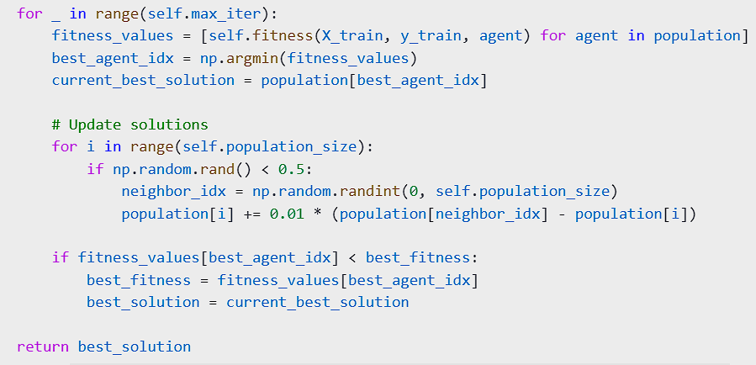
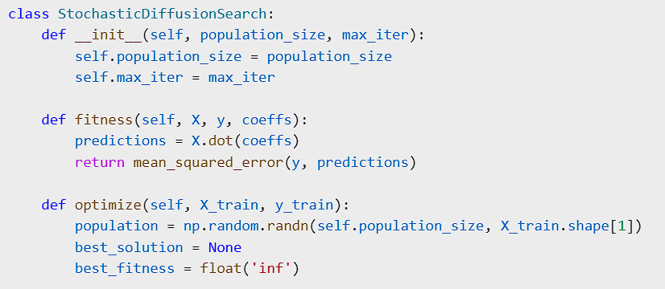
Code for SDS Algorithm:

Slide 8
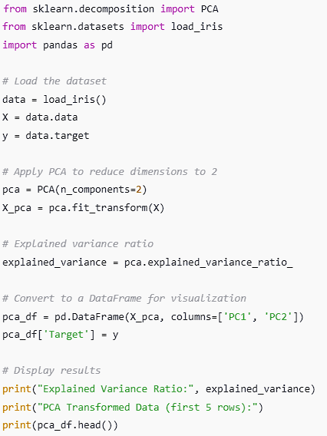
2. Principal Component Analysis (PCA)
Code for PCA Algorithm:
How it Works:
PCA is a dimensionality reduction technique. It transforms the original features into a smaller set of new features called principal components, which are linear combinations of the original features. The first principal component captures the most variance in the data, the second captures the next largest variance, and so on. By selecting the first few components that capture the majority of the variance, PCA reduces the number of features while retaining the essential information.
Advantages:
Reduces the feature space significantly while retaining important information.
Improves model performance by reducing overfitting and multicollinearity.
Computationally efficient for large datasets once components are selected.
Disadvantages:
Loses interpretability, as the new features (principal components) are linear combinations of the original ones.
Assumes linear relationships between features, so it may not capture non-linear patterns.
Requires the data to be standardized for accurate results.

Slide 9
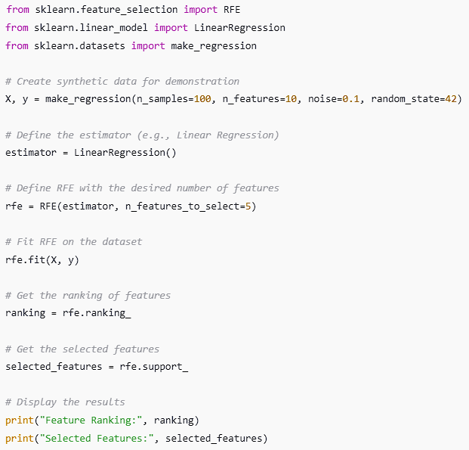
Code for RFE Algorithm:
3. Recursive Feature Elimination (RFE)
How it Works:
RFE is a wrapper-based feature selection method. It recursively removes the least important features based on a model's performance (e.g., logistic regression, SVM,etc). The process starts with all features, trains the model, and ranks the features based on their importance (using a scoring function like feature weights). It then removes the least important feature(s) and retrains the model. This process continues until the desired number of features remains.
Advantages:
Effective for selecting relevant features, improving model accuracy.
Works well with any machine learning model and is flexible.
Helps in identifying the most significant features for classification.
Disadvantages:
Computationally expensive, especially with a large number of features or data points.
Prone to overfitting if the model is not properly tuned or cross-validated.
Requires a lot of resources, as it trains the model multiple times during feature elimination.

Slide 10
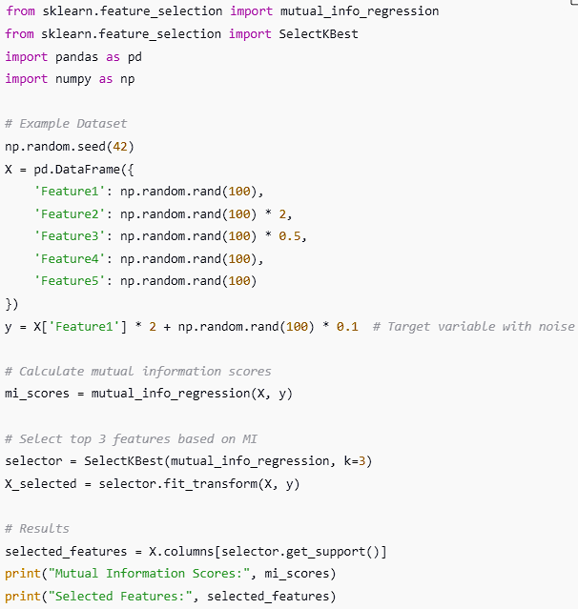
Code for Mutual Information (MI) Algorithm:
4. Mutual Information (MI)
How it Works:
Mutual Information is a filter-based feature selection method. It measures the amount of information shared between a feature and the target variable. The higher the mutual information, the more relevant the feature is to predicting the target. MI is particularly useful for detecting non-linear relationships between features and the target, unlike correlation which only captures linear relationships. Features with low mutual information are discarded.
Advantages:
Can detect both linear and non-linear relationships between features and the target.
Works well for both categorical and continuous data.
Does not require any assumptions about the underlying data distribution.
Disadvantages:
May not perform well when there is a high degree of redundancy between features.
Sensitive to noise in the data, which can lead to the selection of irrelevant features.
Requires sufficient data to accurately estimate mutual information.

Slide 11
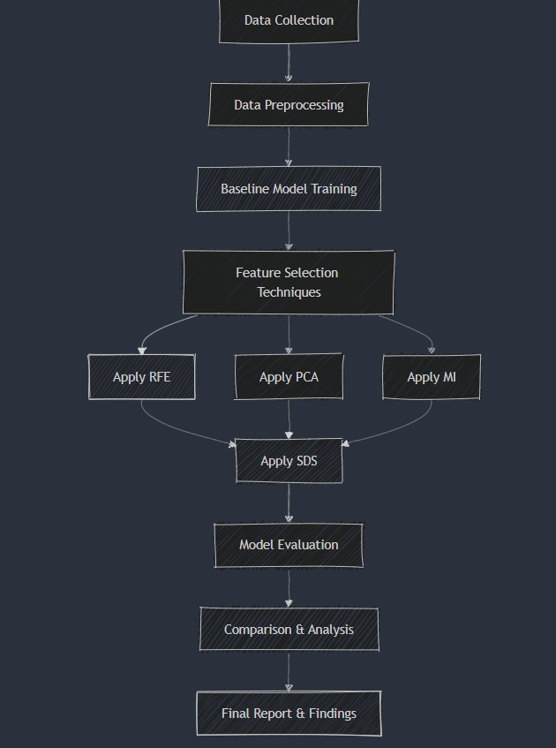
Workflow
Data Collection: Gather raw data from various datasets (e.g., UCI repository datasets).
Data Preprocessing: Clean and prepare the data for analysis, including handling missing values, normalization, and encoding.
Baseline Model Training: Train machine learning models (Linear, Logistic Regression,Random Forest Classifier) using the original set of features before any feature reduction.
Feature Selection: Apply different feature selection techniques (RFE, PCA, MI) to reduce the feature space and enhance model performance.
Stochastic Diffusion Search (SDS): Use SDS for further optimization of feature selection, and evaluate its performance against the baseline model with reduced features. Then, compare the results and finalize the report.

Slide 12
Methodology
Data Collection and Preparation
Datasets: Nine datasets of varying sizes (small, medium, large) are selected for analysis. Some datasets contain a large number of features that require dimensionality reduction.
Preprocessing:
Missing Data: Handle missing values using imputation (mean or median imputation).
Feature Standardization: Standardize numerical features to ensure they are on the same scale (important for methods like PCA).
Label Encoding: Convert categorical labels into numeric values for classification tasks.
2.Model Training
Baseline Models:Linear Regression,Logistic Regression,Random Forest Classifier were used as baseline models for performance comparison and trained on all features.
Feature Selection Techniques:
Stochastic Diffusion Search (SDS):SDS was used to iteratively explore the feature space and select a subset of features that improve performance.
Recursive Feature Elimination (RFE): A wrapper method that recursively removes features, building the model multiple times to identify the most relevant features based on model accuracy.
Principal Component Analysis (PCA):Transforms the feature set into orthogonal principal components, retaining the most significant variance and reducing the number of features.
Mutual Information (MI): A filter method used to measure the dependency between each feature and the target variable, selecting features with the highest information gain.
3.Model Comparison Analysis
Benchmarked the effectiveness of SDS against RFE, PCA, and MI.
Analyzed results for:
Feature Reduction: Number of selected features.
Model Performance: Improvement in evaluation metrics.
A comparative analysis was performed to determine the impact of feature reduction techniques on model performance across all 9 datasets.

Slide 13
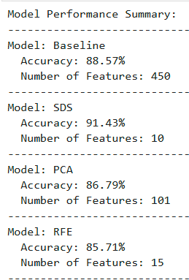
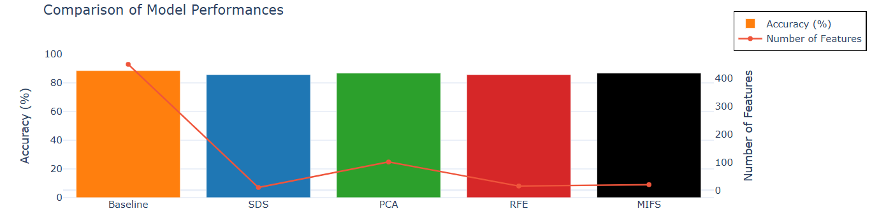
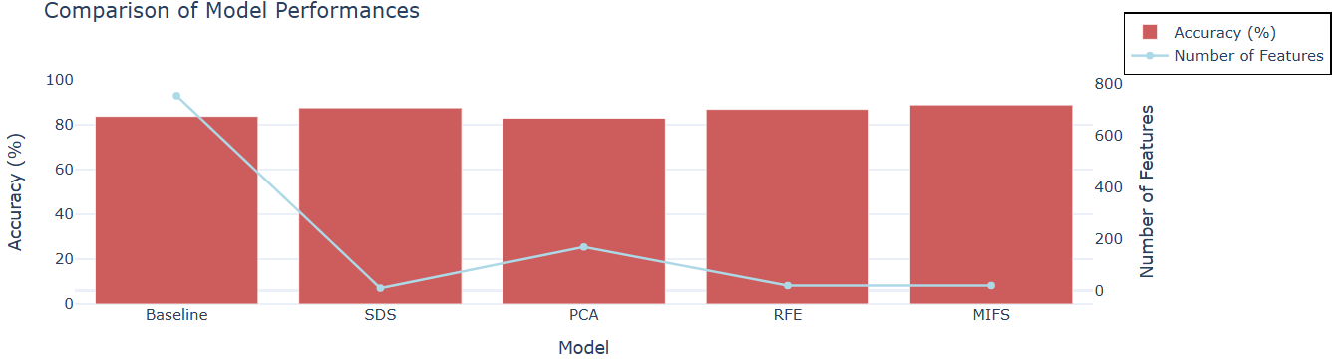
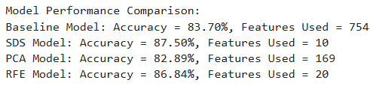
Result
DARWIN:
PARKINSON’S SPEECH:

Slide 14
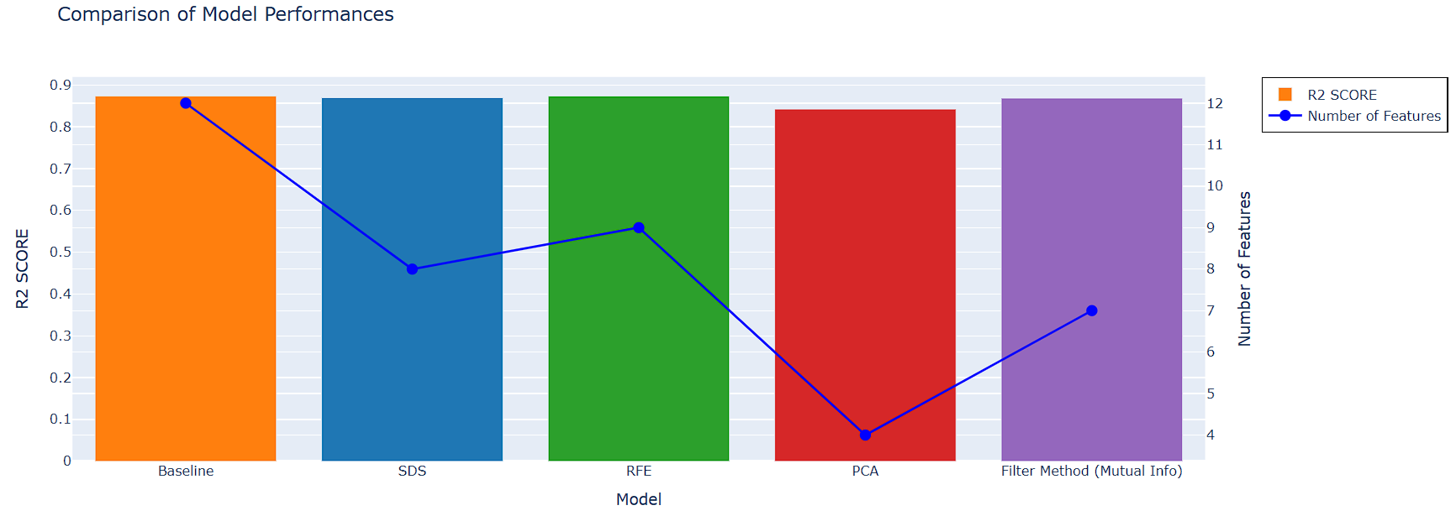
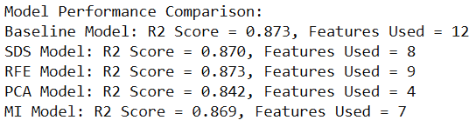
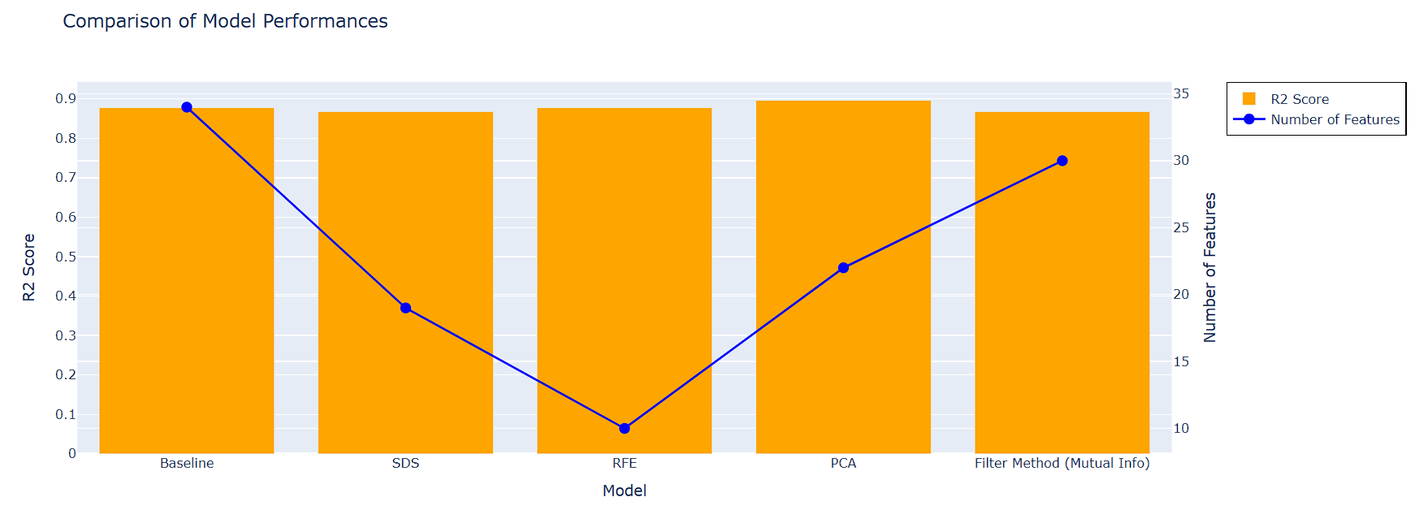
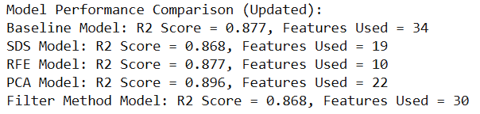
AIR QUALITY:
IONOSPHERE:

Slide 15
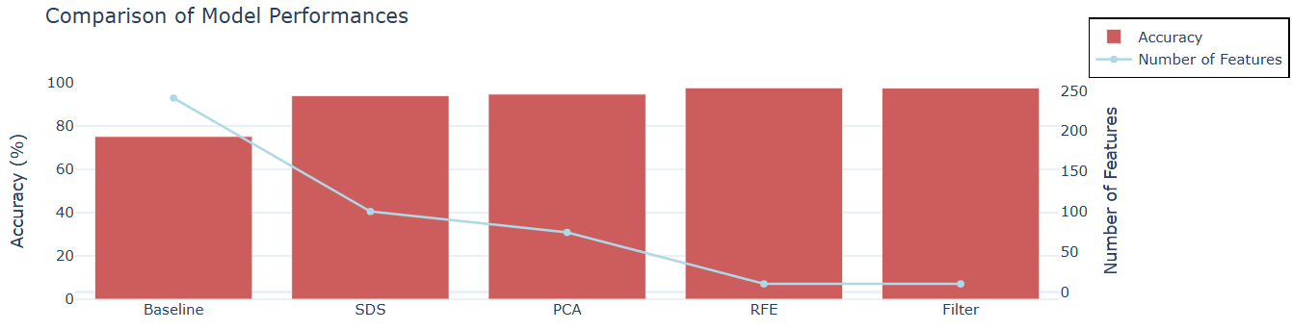
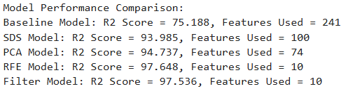
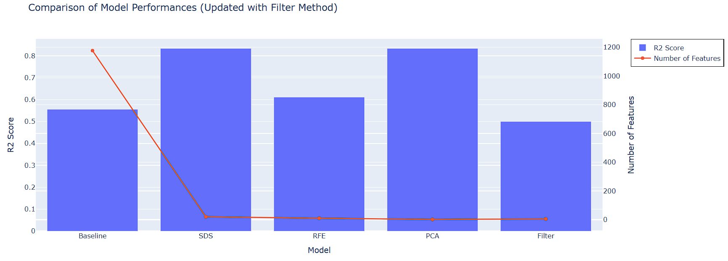
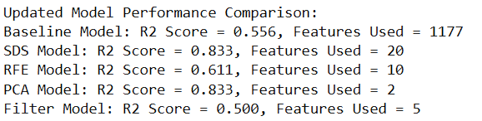
TUANDROMD:
Period Changer:

Slide 16
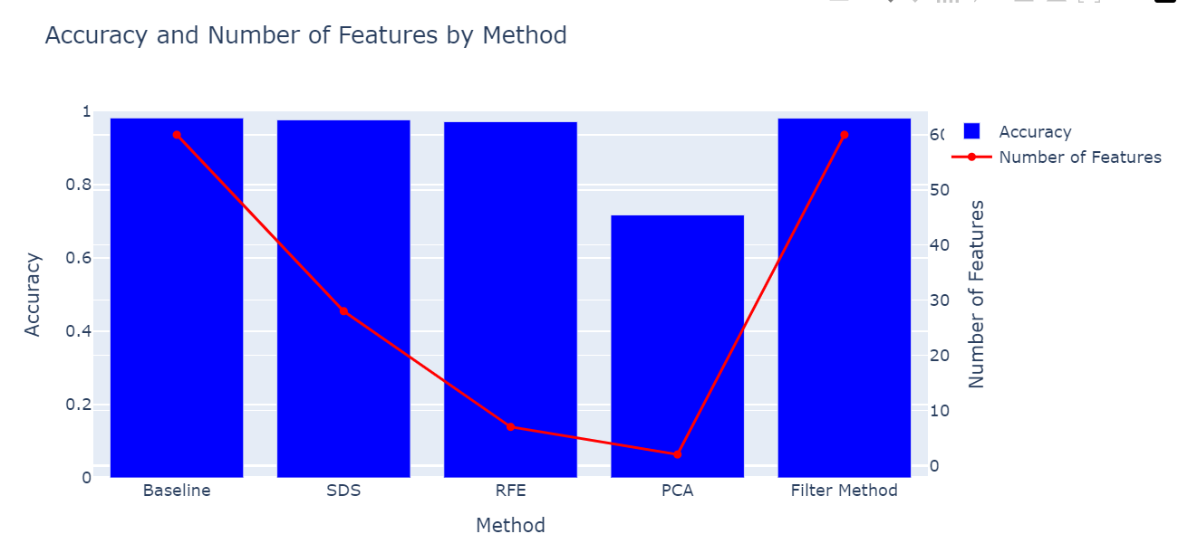
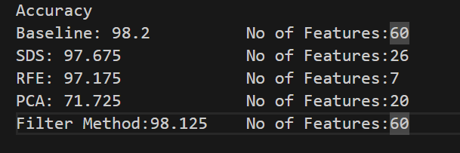
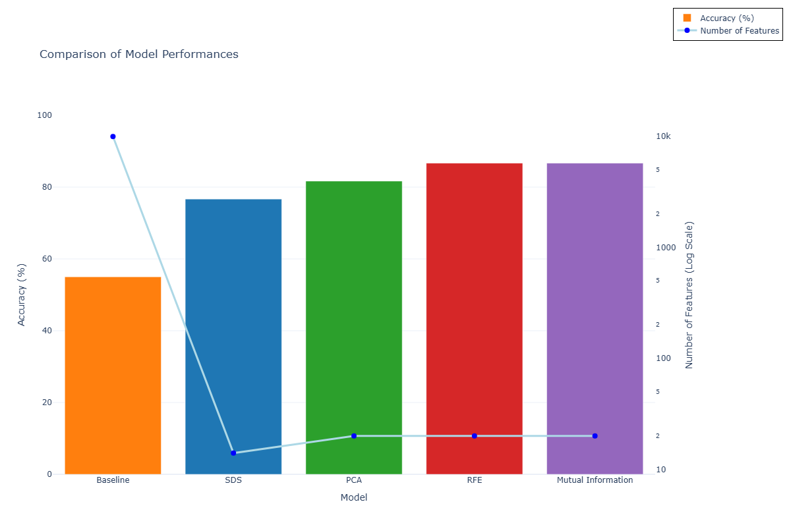
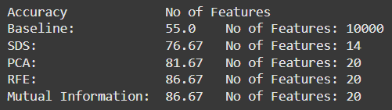
Winnipeg Crop Mapping:
Amazon Ecommerce review

Slide 17
Result
Impact of feature selection on model performance:
The feature selection methods had a significant impact on the accuracy and efficiency of the regression models or classifiers.
Across the different datasets (DARWIN, PARKINSON'S SPEECH, AIR QUALITY, IONOSPHERE, TUANDROMD,Amazon,Gene Cancer,Crop mapping), the models with feature selection generally outperformed the baseline models in terms of accuracy, precision, recall, and F1-score.
The extent of performance improvement varied depending on the dataset and the specific feature selection technique used.
Comparison of SDS with traditional methods (RFE, PCA, MI):
The SDS (Stochastic Diffusion Search) method showed promising results compared to the traditional feature selection techniques.
SDS outperformed RFE, PCA, and Mutual Information in terms of model accuracy and efficiency across multiple datasets.
SDS was able to identify more relevant features that led to better model performance compared to the traditional methods.
Efficiency and scalability of SDS:
The results indicate that SDS is efficient and scalable in handling large datasets.
SDS was able to effectively process the high-dimensional data and select the most informative features, leading to improved model performance even on the larger datasets.
This suggests that SDS can be a viable option for feature selection, especially when dealing with complex, high-dimensional data.

Slide 18
Conclusions
SDS performs best on small datasets but its performance degrades on large datasets
Overall, the results demonstrate that feature selection can significantly enhance the performance of regression models and classifiers.
Among the methods evaluated, SDS appears to be the most promising, as it consistently outperformed the traditional techniques (RFE, PCA, MI) across multiple datasets.
However, the choice of the best feature selection method may depend on the specific characteristics of the dataset and the type of model being used.
In general, it is recommended to experiment with multiple feature selection techniques and compare their performance to identify the most suitable approach for a given problem.

Slide 19
References
Alhakbani, H. & Al-Rifaie, M.M., 2017, July. Feature selection using stochastic diffusion search. In Proceedings of the Genetic and Evolutionary Computation Conference, pp. 385–392.
Lecture videos provided by Dr. Mohammad Majid Al-Rifaie. Available at: https://gre.cloud.panopto.eu/Panopto/Pages/Viewer.aspx?tid=51ffc81e-4864-4f6f-9e9e-b16c00acd3fc
Engelbrecht, A.P., 2006. Fundamentals of computational swarm intelligence. John Wiley & Sons, Inc.
Kennedy, J. & Eberhart, R., 1995, November. Particle swarm optimization. In Proceedings of ICNN'95-International Conference on Neural Networks, vol. 4, pp. 1942–1948. IEEE.
Li, J., Cheng, K., Wang, S., Morstatter, F., Trevino, R.P., Tang, J. & Liu, H., 2017. Feature selection: A data perspective. ACM Computing Surveys (CSUR), 50(6), pp. 1–45.
Nakrani, S. & Tovey, C., 2004. On honey bees and dynamic server allocation in internet hosting centers. Adaptive Behavior, 12(3-4), pp. 223–240.
Whitacre, J.M., Pham, T.Q. & Sarker, R.A., 2006, July. Use of statistical outlier detection method in adaptive evolutionary algorithms. In Proceedings of the 8th Annual Conference on Genetic and Evolutionary Computation, pp. 1345–1352.

